Slide 1

KLU Design Thinking for Innovation, Phase 2 Work In Progress Submission 1
Batch-12 Group-D 01/02/2021

Slide 2

Submitted Together with this Report
Interview protocols for all target groups
Interview reports for all Interviews
Focus group agendas for all target groups
Focus group summary reports for all focus groups
Group participation report for this portion of the project

Slide 3

1. Our Most Important Learnings
Children are interested in using Gadgets and watching media.
This is gained from interviews. Most of the children now-a-days are attracted towards using the gadgets and watching the movies, cartoons etc. Moreover, the kids who are using the gadgets and watching the shows are learning English much faster than others. So, we can use these to our solution.
Children's surrounding has a great impact on them.
This is gained from interviews. This tells us that most the students acquire the habits from the surroundings they live in.
Children loves to play games because they enjoy them more!
This is gained from interviews. This tells us that our solution must make children to enjoy so that they love it and at the same time they will understand and able to receive instructions in English.

Slide 4

2. Other Things We Learned
The Kind of Learning to pre-schooler's could be more of activity based rather than theoretical.
01
We learned that parents, teachers and siblings can be a great influence for the children to learn English.
02
We have understood how internet, books, parents and teachers would impact children.
03
We learned how to conduct focus group activities to understand views of the people.
04

Slide 5


3. Things we Saw and Heard
“OUR KIDS SPEND MORE TIME ON CARTOONS AND TELEVISION SHOWS”. (Parents)
“Teaching creatively with different methods will have strong impact on children instead of teaching alphabets in a classroom repeatedly” (parents)
"We heard that the teachers not assigning any interesting tasks to build the interaction among the children." (parents)
"Children learn from their surroundings so practical activities and entertainment shows can influence them in a good way" (Relatives)

Slide 6

INTERVIEW PROTOCOL

Slide 7

INTERVIEW PROTOCOL
Target Group: Parents
We need to know
We should ask them
Their feelings about their abilities
Their leisure hours
Parents of preschool students in AP
Their feelings about interests
1.How much do you support your child to learn?
2.What kind of activities do you teach to your child?
3.How much do you help your child to learn?
4.What are the daily activities of your children in free time?

Slide 8

INTERVIEW PROTOCOL
Target Group: pre-schoolers
We need to know
We should ask them
Their entertainment choices.
Their learning habits
Their idle hour activities
Their exposure to Entertaiment shows
What do you like to do when you play?
How did you learn about activities
What are your favorite, movies , shows and songs?
What do you like to watch cartoon shows or any other media ?

Slide 9

INTERVIEW PROTOCOL
Target Group: Teachers
We need to know
We should ask them
Their feeling about children's abilities
Their Performance
Their encouragement towards children
Their Interaction with the children
what way do you teach the things to child to learn?
How do they actively participate in the class?
How do you encourage the students to learn new things?
How you are interacting with your students during the classes?

Slide 10

INTERVIEW REPORT

Slide 11

INTERVIEW REPORT
Target Group: Parents
Person interviewed: Mrs. chandu
Mrs. chandu lives in Guntur. She works as a manager since 2010. We have interviewed her on the topic what makes a good parent-child relation. According to her learning should start from home with help of parents in healthy and friendly atmosphere with parents. positive relationships between parent & children are key to child development and It is very important to spend some quality time, where these moments give a chance to communicate positive messages and teach them as responsibilities. As we know that parents are the first teachers to their children, so they can motivate their children to learn and speak in English by explaining its importance from their pre ages.
Date: 27-01-2021

Slide 12
INTERVIEW REPORT
Target Group: Teachers
Person Interviewed: Ms. M. Gagana
Ms. M. Gagana lives in Vijayawada and she is a primary school teacher. We have interviewed her regarding her views towards the English language and importance in learning English. She said that English is the universal language and a medium of communication used by everyone around the globe. It's very important to learn English and develop communication skills.as if children had been learning from their pre age they can easily get into that and keep understanding . We also need to know their interests and need to train them in their ways of understanding.
Date: 28-01-2021

Slide 13
INTERVIEW REPORT
Target Group: Parent
Date: 27-01-2021
Person interviewed: Mr. Kishore
Mr. Kishore lives in Hyderabad. He works as an accountant in an organization. This interview was quite different and exciting for me as Mr. Ajay would spare more quality time with his daughter as compared to his wife. I first asked him what was his opinion on English language and what impact does it make on kids of this generation. He said," In this developing nation , it has become necessary to be well versed with English for everyday communication and activities. In this generation, it's good that kids get to learn English better and at a quick pace, but old traditions and old languages are being forgotten ".The next thing which I have asked him was how would he encourage his daughter to spend time on toddler books and how far is she interested in it.

Slide 14
INTERVIEW REPORT Target Group: Parents Date: 26-01-2021
I interviewed a parent of a preschooler. By this interviewed I want to know their abilities, feelings about their children, their opinion and expectation on English medium school.
When I asked few question I got to know that parents should make their children feel comfortable while studying because as children will always feel to play games and watch entertainment programs it will be hard to concentrate on studies.
When asked a parent that how much do you help your child to learn?
The parent said it’s hard to make the children study because they cannot sit in one place and study because they have to play game with toys so they start buying the toys which will spell all alphabets and rhythms then the kid will happily listen to that and study. She mentioned that kids will be interested if they learn from different kind of things.
When I asked why to want your kid to learn English?
Parent replied that English is a universal language by which they can communicate all over the world with anyone. The world is growing bigger and when they got job opportunities they have to travel different places then the common language will be English and it is very convenient for them to communicate without hesitation
From this interviewed I conclude that parents put a lot of efforts in kids learning process

Slide 15

FOCUS GROUP AGENDA
WE NEED TO KNOW
We Should Assign Them To…
Minutes
Each one draws a picture that shows how you feel about Class One (First Grade). Then, show your pictures the group and everyone discuss what your fellow panellists show you.
Rank the things that need to be implemented. So that children will be able to receive and understand the instructions in English
Each one should question(why) and again need to re-question the same question(Laddering)
Their thoughts and feelings about primary education
Priorities which enable children to understand or receive the instructions in English
Reasons why children are unable to understand or receive the instructions in English
20
20
20

Slide 16
FOCUS GROUP AGENDA
WE NEED TO KNOW
We Should Assign Them To…
Minutes
Each one of the panellists should document their experience encountering English language and let them elaborate it to their group.
Each panellist has to rate the present curriculums along with some of their reasons for giving that rating
Each one document your experience. So that children will be able to receive and understand the instructions in English
20
20
20
Their perception about English language
Their feeling about present curriculum
Their thoughts to make children able to understand or receive the instructions in English

Slide 17

FOCUS GROUP SUMMARY REPORT
We have conducted focus group activity. We had about 7 people from target groups. The first activity we have conducted is Introducing. So, they can feel comfortable all through the activity. Then we told them to document their experience in English to know how well they can influence the children.
And we conducted another activity Laddering to know the reasons behind why children are unable to understand or receive the instructions in English. They listed out some reasons like Parents have no knowledge of English, Their surroundings are not with people who speak in English, teachers are unable to find the interests of children Etc. In the similar way we conducted few more activities

Slide 18

FOCUS GROUP SUMMARY REPORT
Parents want their children to be proactive in all activities
Children like to watch Cartoons/ Entertainment shows
Parents feel that the present curriculum isn't better.
INSIGHTS GAINED FROM FOCUS GROUPS ​
EXACT WORDS SPOKEN BY PANELISTS
“I Wish My Child Could Be More Active Than She’s Now”.
“He Spends more time watching Cartoons/ Entertaining Shows”.
“I’m Worried That My Kid will be able to apply the things what he has learnt.”

Slide 19
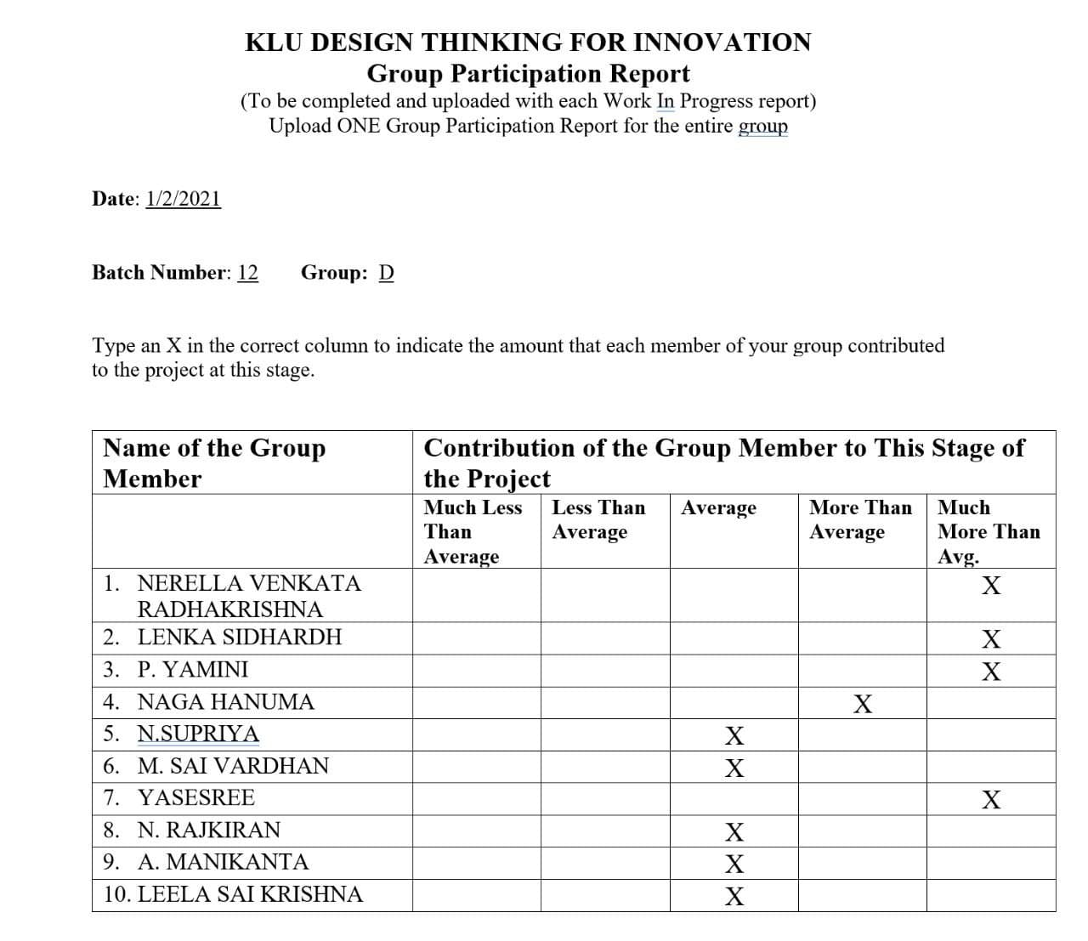

Group Participation Report

Slide 20


FROM-BATCH-12 PROJECT-D

